Slide 1
All pictures are at 1000X unless otherwise specified
The yellowish pictures are from lugol samples, while blueish pictures are from living cells from plankton net
On the slides, « Species nickname » is the name I gave that particular cell in my dataset to distinguish the unknown or two different yet unidentified species from the same genus
Scale on the picture to µm conversion:
1000X → 1 unit = 1 µm
400X → 1 unit = 2.5 µm
200X → 1 unit = 5 µm

Slide 2
A

Slide 3
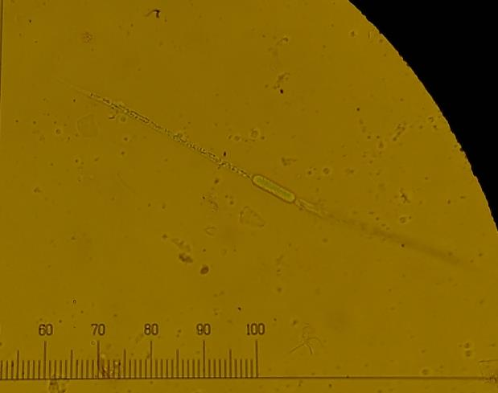
Phylum: Cyanobacteria
Genus: Aphanizomenon
Species: flos-aquae
Species nickname: filament

Slide 4
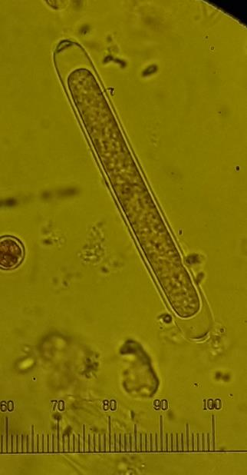
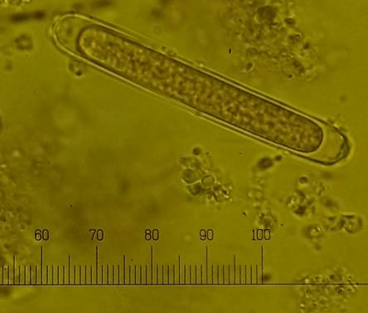
Phylum: Cyanobacteria
Genus: Aphanizomenon
Species: flos-aquae
Species nickname: akinete

Slide 5
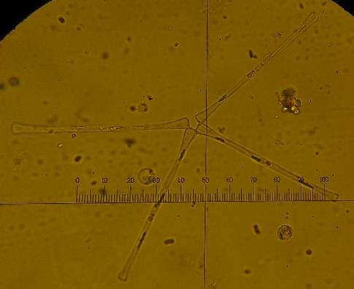
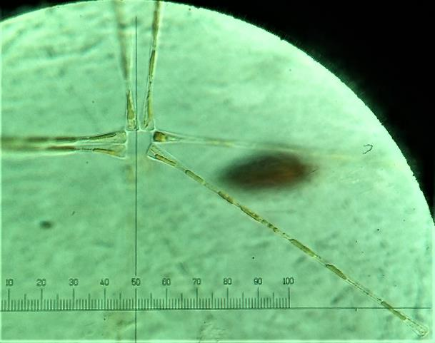
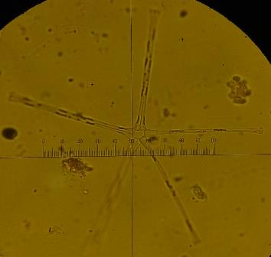
Phylum: Bacillariophyceae
Genus: Asterionella
Species: formosa

Slide 6
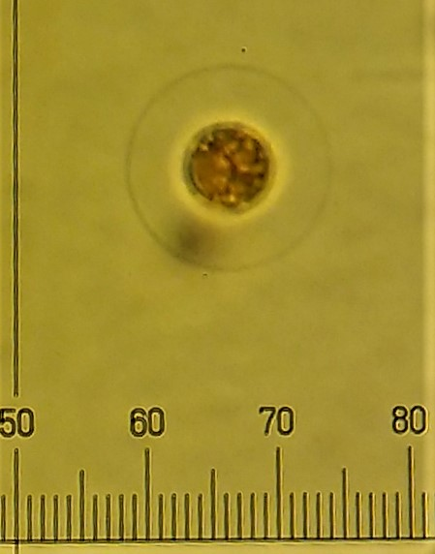
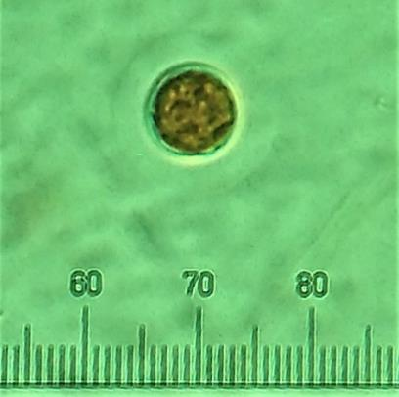
Phylum: Chlorophytes
Genus: Asterococcus
Species: unknown

Slide 7
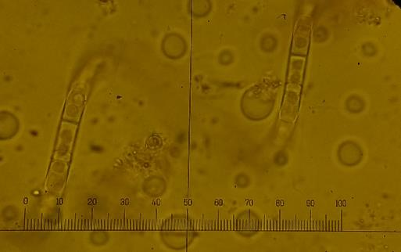
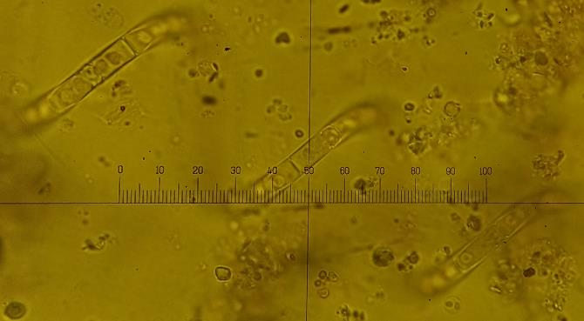
Phylum: Bacillariophyceae
Genus: Aulacoseira
Species: c.f. italica due to curved cells

Slide 8
B

Slide 9
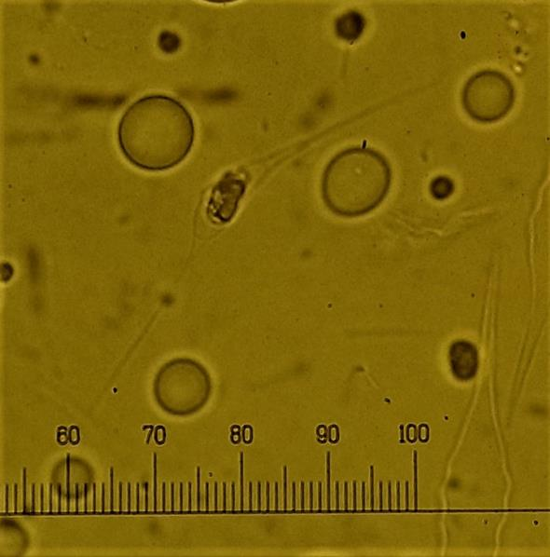
Phylum: Chrysophytes
Genus: Bitrichia
Species: unknown

Slide 10
C

Slide 11
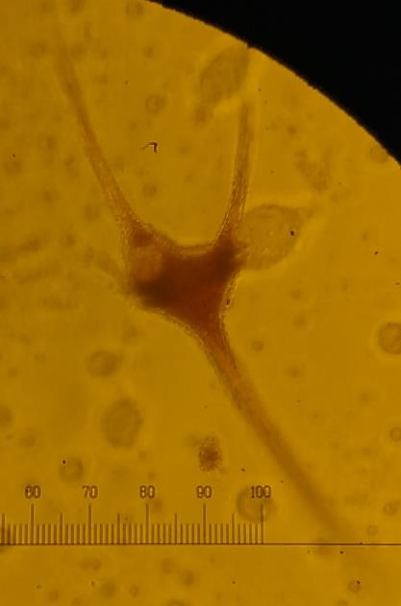
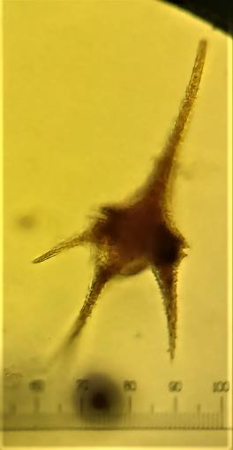
Phylum: Dinoflagellates
Genus: Ceratium
Species: hirundinella
400x

Slide 12
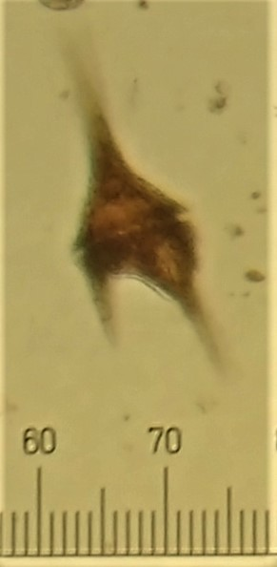
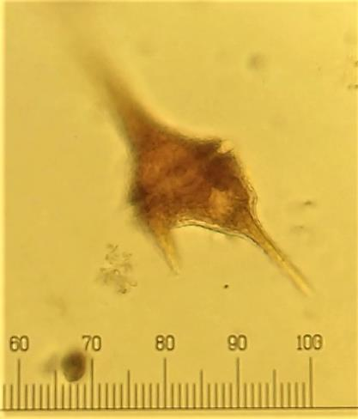
Phylum: Dinoflagellates
Genus: Ceratium
Species: furca
200x
400x

Slide 13
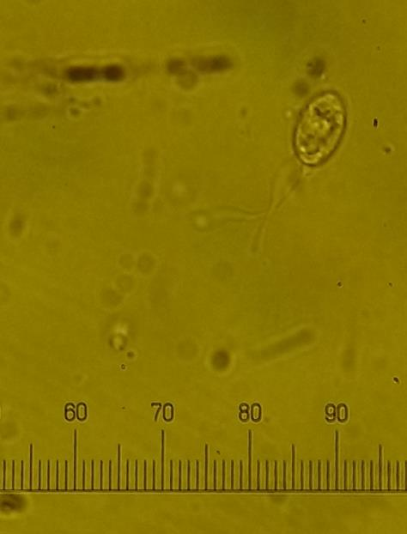
Phylum: Chrysophytes
Genus: Ochromonas?
Species: unknown
Chlamydomonas? Not sure I do not see the cup shaped chloroplast but maybe

Slide 14
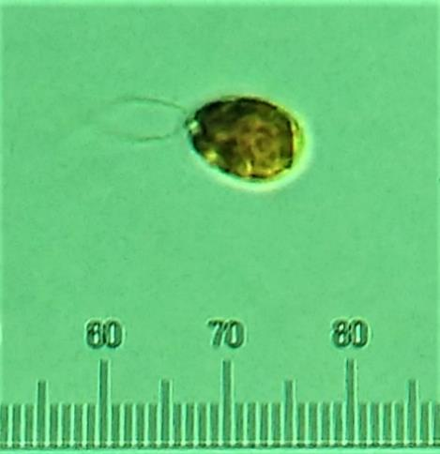
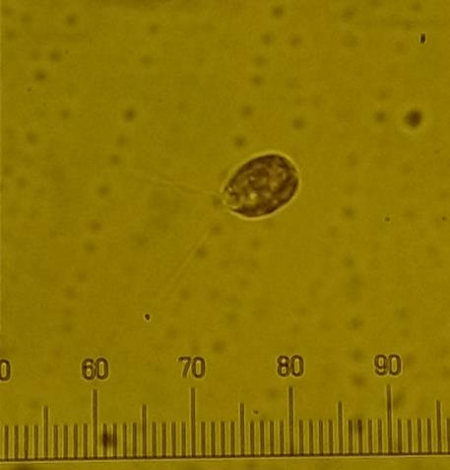
Phylum: Chlorophytes
Genus: Chloromonas
Species: unknown

Slide 15
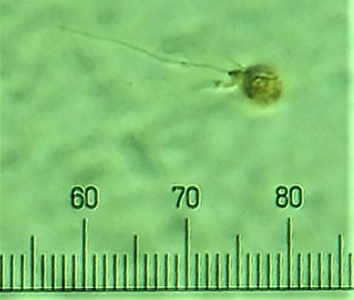
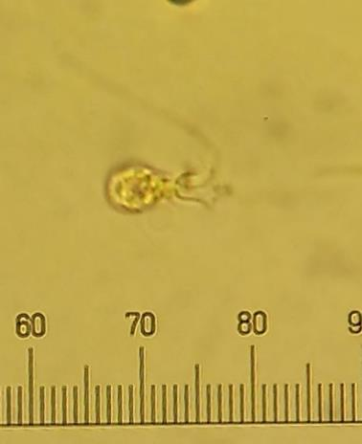
Phylum: Choanoflagellate
Genus: unknown
Species: unknown
--Salpingoecidae.

Slide 16
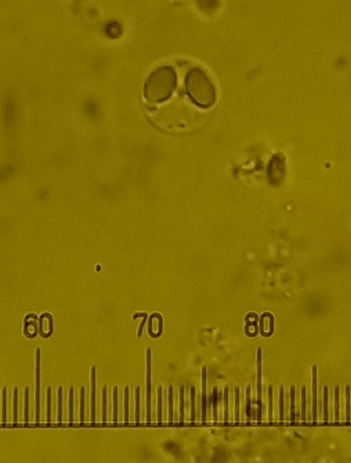
Phylum: Haptophytes
Genus: Chyrsochromulina
Species: parva

Slide 17
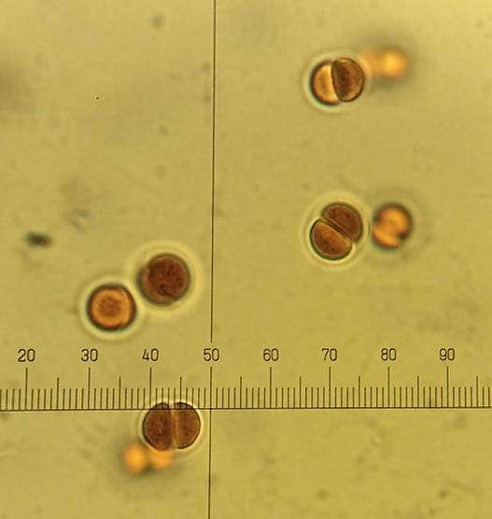
Phylum: Cyanobacteria
Genus: Chroococcus
Species: unknown

Slide 18
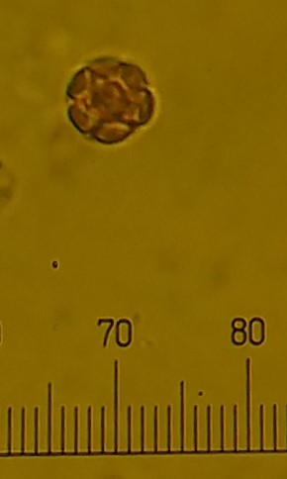
Phylum: Chlorophytes
Genus: Coelastrum
Species: unknown

Slide 19
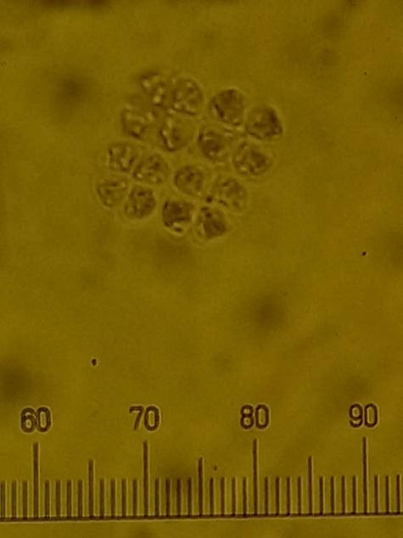
Phylum: Chlorophytes
Genus: Crucigenia
Species: unknown

Slide 20
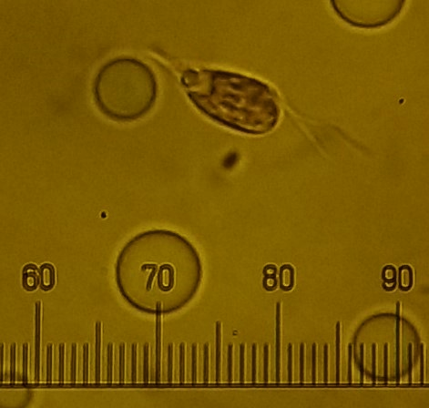
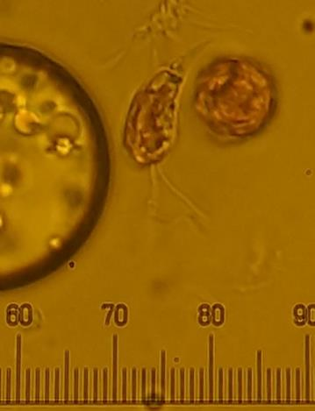
Phylum: Cryptophytes
Genus: Cryptomonas
Species: marssonii

Slide 21
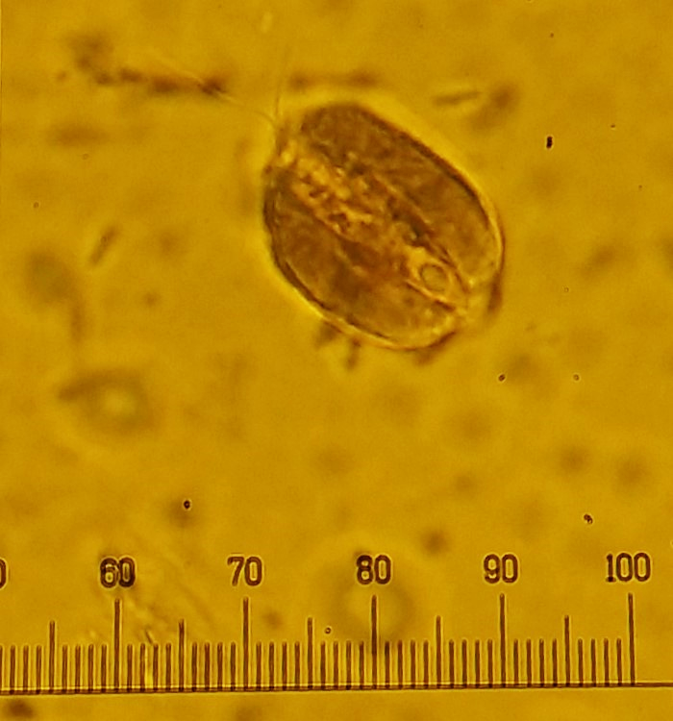
Phylum: Cryptophytes
Genus: Cryptomonas
Species: ovata

Slide 22
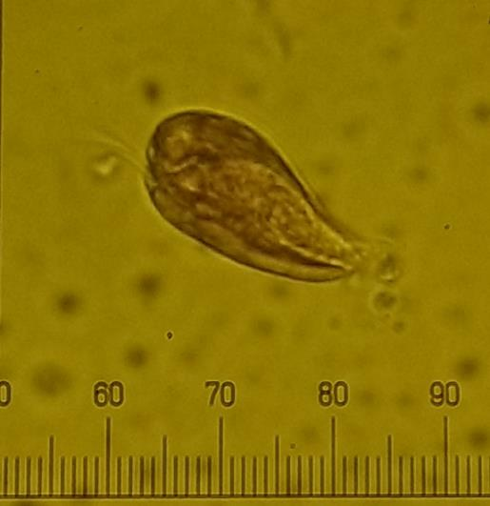
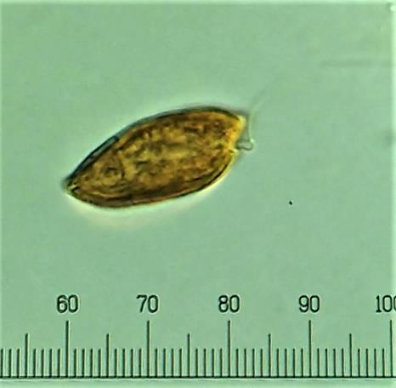
Phylum: Cryptophytes
Genus: Cryptomonas
Species: unknown

Slide 23
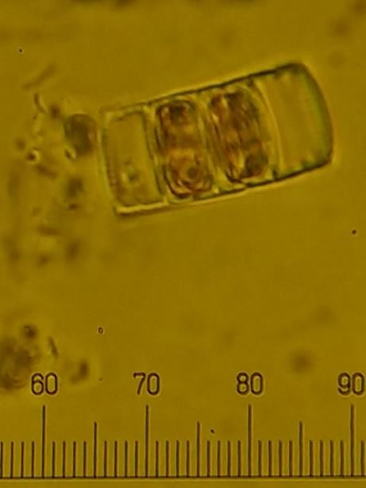
Phylum: Bacillariophyceae
Genus: Cyclotella
Species: unknown

Slide 24
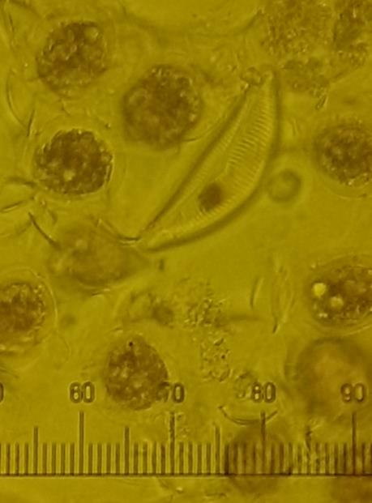
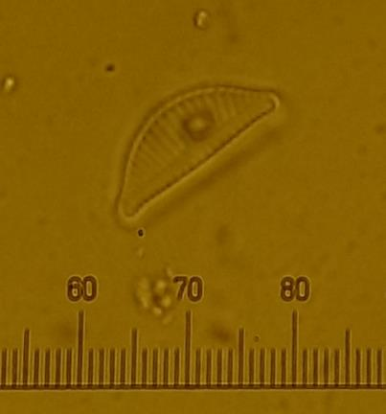
Phylum: Bacillariophyceae
Genus: Cymbella
Species: unknown

Slide 25
D

Slide 26
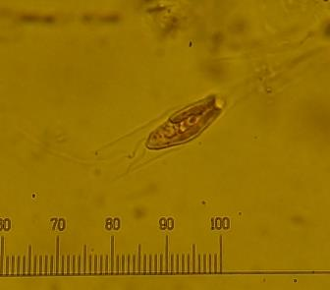
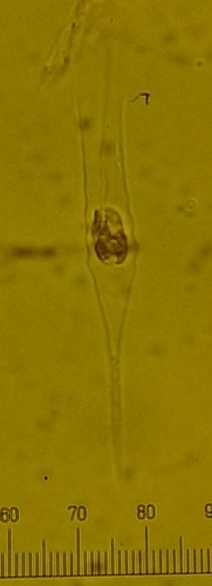
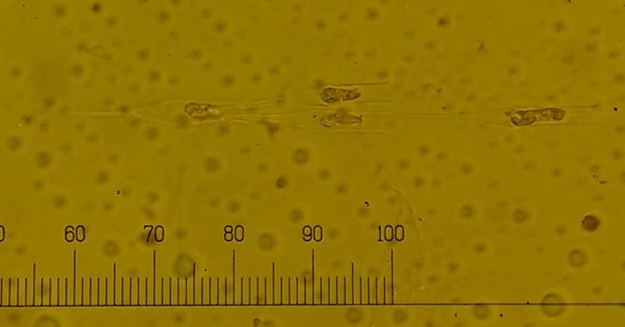
Phylum: Chrysophytes
Genus: Dinobryon
Species: bavaricum

Slide 27
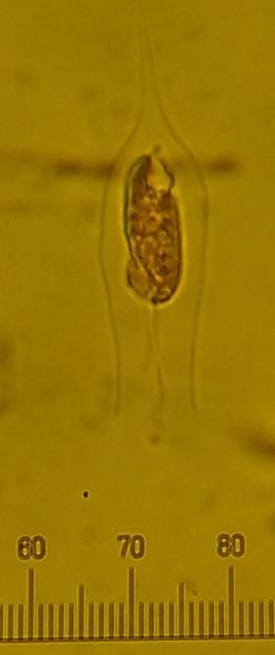
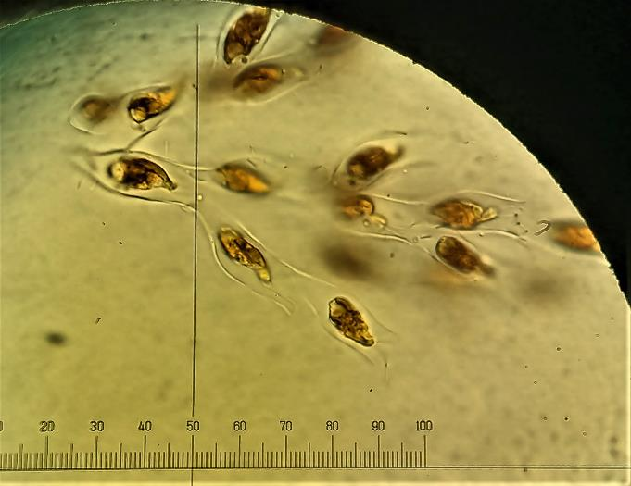
Phylum: Chrysophytes
Genus: Dinobryon
Species: divergens

Slide 28
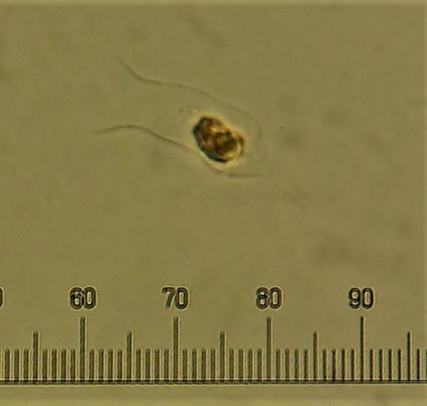
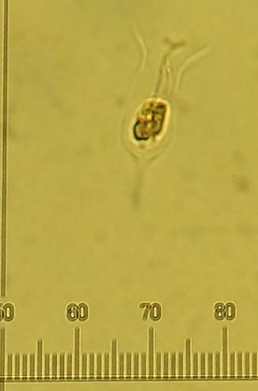
Phylum: Chrysophytes
Genus: Dinobryon
Species: petiolatum

Slide 29
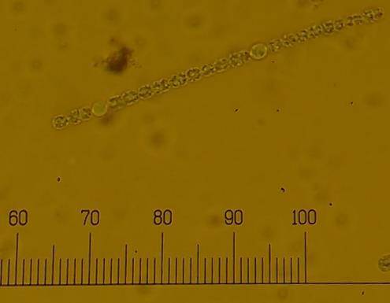
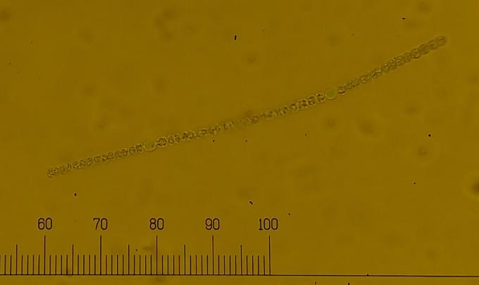
Phylum: Cyanobacteria
Genus: Dolichospermum
Species: planctonicum

Slide 30
E

Slide 31
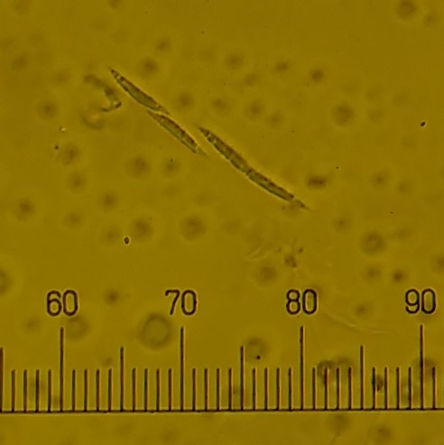
Phylum: Chlorophytes
Genus: Elakatothrix
Species: unknown

Slide 32
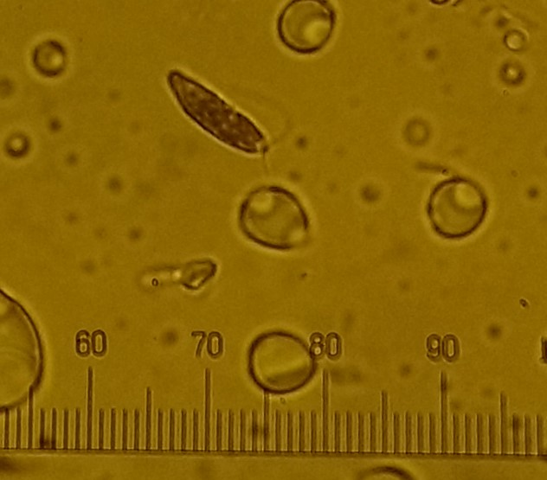
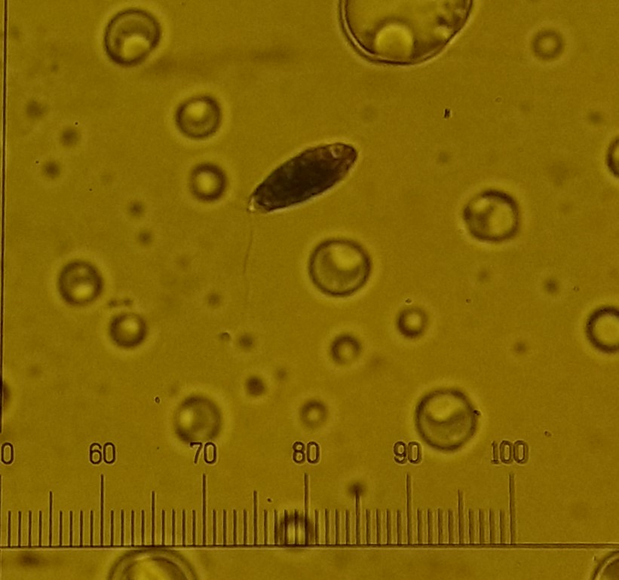
Phylum: Euglenoid
Genus: Eutreptia?
Species: unknown

Slide 33
G

Slide 34
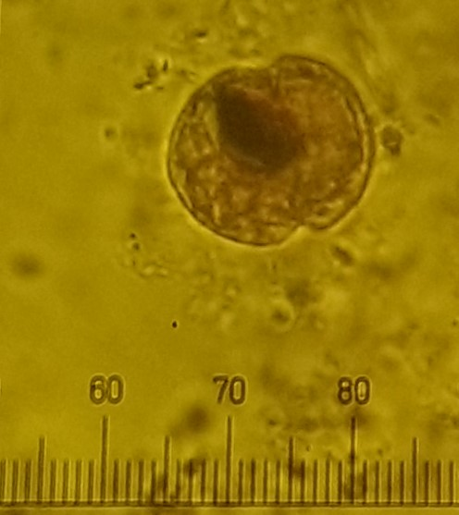
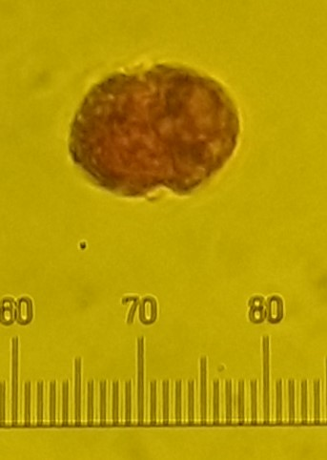
Phylum: Dinoflagellates
Genus: Borghiella
Species: unknown

Slide 35
K

Slide 36
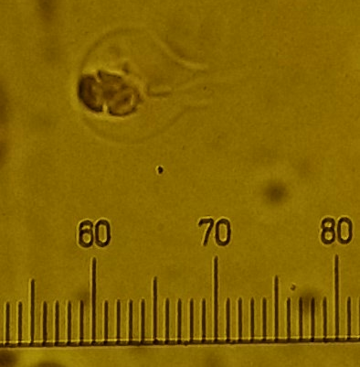
Phylum: Chrysophytes
Genus: Kephyrion
Species: unknown
Species nickname: ampoule

Slide 37
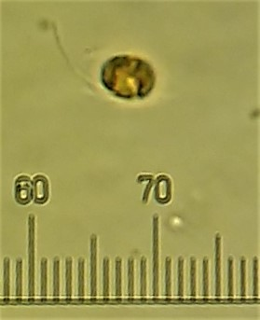
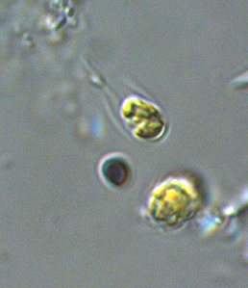
Phylum: Chrysophytes
Genus: Kephyrion
Species: unknown
Species nickname: u
Photo from internet

Slide 38
M

Slide 39
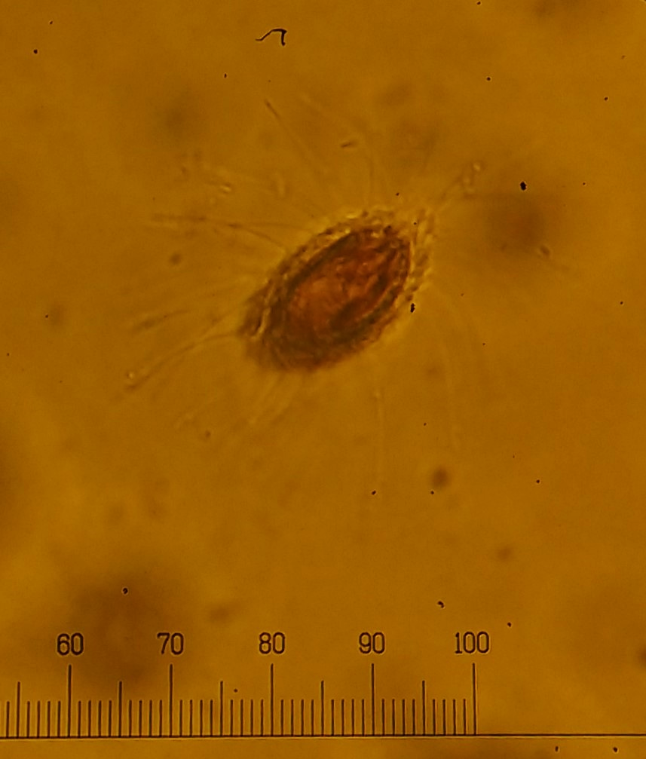
Phylum: Chrysophytes
Genus: Mallomonas
Species: caudata

Slide 40


Phylum: Chrysophytes
Genus: Mallomonas
Species: tonsurata

Slide 41

Phylum: Cyanobacteria
Genus: Merismopedia
Species: Unknown

Slide 42


Phylum: Ciliates
Genus: Mesodinium
Species: unknown

Slide 43
O

Slide 44

Phylum: Chlorophytes
Genus: Oocystis
Species: unknown

Slide 45
P

Slide 46

Phylum: Chlorophytes
Genus: Pediastrum
Species: duplex

Slide 47

Phylum: Cyanobacteria
Genus: Pseudanabaena
Species: unknown

Slide 48



Phylum: Cyanobacteria
Genus: Unknown
Species: unknown
Species nickname: picocyanobacteria

Slide 49


Phylum: Dinoflagellates
Genus: Peridinium
Species: unknown
Species nickname: pointu
400x
Thèque vide

Slide 50


Phylum: Dinoflagellates
Genus: Peridinium
Species: unknown
Species nickname: rond

Slide 51

Phylum: Dinoflagellates
Genus: Peridinium
Species: unknown
Species nickname: rond
Phylum: Dinoflagellates
Genus: Peridinium
Species: unknown
Species nickname: pointu

Slide 52

Haptonema
Phylum: Haptophytes
Genus: Chrysochromulina
Species: unknown

Slide 53
R

Slide 54

Phylum: Cyanobacteria
Genus: Rabdoderma
Species: unknown

Slide 55
S

Slide 56


Phylum: Chlorophytes
Genus: Scenedesmus
Species: quadricauda

Slide 57

Phylum: Chlorophytes
Genus: Staurastrum
Species: unknown

Slide 58



Phylum: Ciliates
Genus: Strombidium
Species: unknown
Top view
Side view
Side view

Slide 59

Phylum: Bacillariophyceae
Genus: Synedra
Species: unknown

Slide 60


Phylum: Chrysophytes
Genus: Synura
Species: uvella? spinosa?

Slide 61
T

Slide 62


Phylum: Bacillariophyceae
Genus: Tabellaria
Species: fenestrata

Slide 63

Phylum: Chlorophytes
Genus: Tetraedron
Species: regulare

Slide 64


Phylum: Euglenophytes
Genus: Trachelomonas
Species: unknown
Nickname species: round

Slide 65

Phylum: Euglenophytes
Genus: Trachelomonas
Species: unknown
Nickname species: oval

Slide 66
U

Slide 67


Phylum: Ciliates
Genus: Uronema
Species: unknown

Slide 68


Phylum: Bacillariophycaea
Genus: Urosolenia
Species: unknown
No cell inside, only shell
Cell inside, half the shell

Slide 69


Phylum: Chlorophyta
Genus: c.f. Polytomella
Species: unknown
Species nickname: hairy

Slide 70
To be identified

Slide 71


To be identified:
Phylum: Haptophytes
Genus: Chrysochromulina?
Species: unknown
Species nickname: cherry

Slide 72


To be identified:
Phylum: Chlorophytes
Genus: Chlorogonium
Species: unknown
Species nickname: epipixis -like

Slide 73



To be identified:
Phylum: Cercozoa
Sandonidae
Genus: Unknown
Species: unknown
Species nickname: vitré

Slide 74


To be identified:
Phylum: Cryptophytes
Genus: Unknown
Species: unknown
Species nickname: small cryptophyta

Slide 75

To be identified:
Phylum: Cyanobacteria
Genus: Coelosphaerium?
Snowella?
Species: unknown

Slide 76



To be identified:
Phylum: Chlorophyceae
Genus: stichococcus? Ophiocytium
Species: e.g. capitatum
Species nickname: haricot

Slide 77

To be identified:
Phylum: Cyanobacteria
Genus: Dolichospermum
Species: c.f. cylindricum

Slide 78

To be identified:
Phylum: Ciliates
Genus: Unknown
c.f. Glaucoma scintillans
Species: unknown
Species nickname:
Immense ciliate

Slide 79

To be identified:
Phylum: Unknown
Genus: Unknown
Species: unknown
Species nickname:
Boule triangle

Slide 80

To be identified:
Phylum: Unknown
Genus: Unknown
Species: unknown
Species nickname:
Flagellé vert

